Slide 1
Database Systems
Chapter 1
ITM 354

Slide 2



File Processing Systems
Billing
Program
Purchasing
Program
Customer
file
Accounts
receivable
file
Buyer
file
Inventory
file
Vendor
file
Accounts_Payable
Program
Sales Order Processing
Program
Payroll
Program
Vendor
file
Invoice
file
Customer
file
Inventory
file
Employee
file
Notes:
1

Slide 3


Database Approach
Order Dept.
Accounting
Dept.
Payroll
Dept.
Program
A
Program
B
Program
C
Ordering
filing
System
Invoicing
System
Payroll
System
Back
Orders
file
Inventory
Master
file
Customer
Master
file
Inventory
Pricing
file
Employee
Master
file
Notes:
1

Slide 4
Database vs. File-based
Miniworld as data source
  Universe of Discourse (UOD)
Logically integrated files
Intended users and applications
Shared and Self-describing
Compared with file-based approach:
  - program-data independence
  - multiple view of data
  - multi-user transaction processing

Slide 5
Types of Databases and Database Applications
Numeric and Textual Databases (e.g. IRS CADE)
Multimedia Databases (e.g. Cortina)
Geographic Information Systems (GIS)
Data Warehouses
Real-time and Active Databases

Slide 6
Basic Definitions
Database: A collection of related data.
Data: Known facts that can be recorded and have an implicit meaning.
Mini-world: Some part of the real world about which data is stored in a database. For example, student grades and transcripts at a university.
Database Management System (DBMS): A collection of software to facilitate the creation and maintenance of a DB.
Database System: The DBMS software together with the data. Sometimes, applications are also included.

Slide 7
Database System Environment
Users/Programmers
Application Programs/Queries
DBMS
Software
Software to Process Queries/Programs
Software to Access Stored Data
Stored DB
Definition
(Meta-Data)
Stored
Database

Slide 8
Why the Database Approach?
Application needs constantly changing
Ad hoc questions need rapid answers
Need to reduce long lead times and high cost in new application development
Lots of data shared throughout the organization
Need to improve data consistency and control access to data
Substantial dedicated programming assistance typically not available

Slide 9
Core DB Technology Trend
Relational Database
Distributed Database
Multi-dimensional databases
Object Relational Database
Object-Oriented Database
Multimedia Database
Intelligent Database
Data warehousing, data marts, data mining
Web-based Databases

Slide 10
DB Time Line
Web-based
Data Warehousing
Client-server
multimedia
heterogeneous
Data Management
Capability
object-oriented
expert, distributed
SQL Standard
commercial DBMS
PC DBMS
ER model
network model
Relational Model: Codd
Hierarchical: IMS
file management
magnetic tape
1945
1961
1970
1976
1980 1985
1990
2000

Slide 11
DBMS
A collection of software
  manage different applications for a multi-user database system
  enable users to define/create and manipulate data
Basic functions:
  multiple user interfaces
  controlled redundancy
  integrity control
  security: authorization & protection
  concurrency & recovery control

Slide 12
Example Database (with Conceptual Data Model)
Mini-world for the example: Part of a UNIVERSITY environment.
Some mini-world entities:
  STUDENTs
  COURSEs
  SECTIONs (of COURSEs)
  (academic) DEPARTMENTs
  INSTRUCTORs
Note: The above could be expressed in the ENTITY-RELATIONSHIP data model.

Slide 13
Example Database (with Conceptual Data Model) – 2.
Some mini-world relationships:
  SECTIONs are of specific COURSEs
  STUDENTs take SECTIONs
  COURSEs have prerequisite COURSEs
  INSTRUCTORs teach SECTIONs
  COURSEs are offered by DEPARTMENTs
  STUDENTs major in DEPARTMENTs
Note: The above could be expressed in the ENTITY-RELATIONSHIP data model.

Slide 14
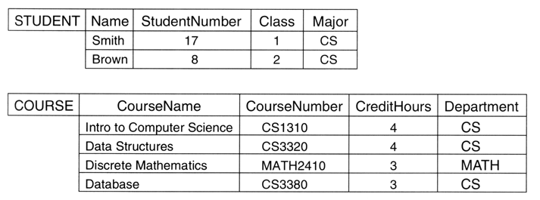
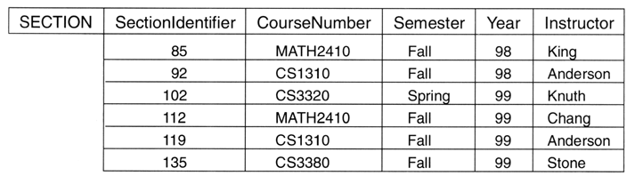

Slide 15

Example E-R Model

Slide 16
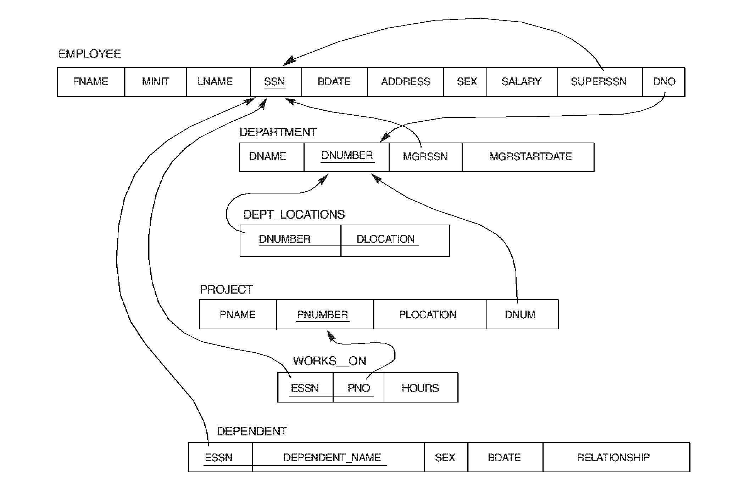
Relational Logical Schema Example

Slide 17

Example Relational Database Snapshot

Slide 18
Features of the E-R Model
Relationships are just as important as entities—they are data that need to be stored in the DB
Most relationships are binary, but they may be ternary (or more!) as well
Questions:
  What is the relationship between three binary relationships and a ternary relationship?
  Why are there two relationships between projects and employees?

Slide 19
Main Characteristics of the Database Approach
Self-describing nature of a database system: A DBMS catalog stores the description of the database. The description is called meta-data). This allows the DBMS software to work with different databases.
Insulation between programs and data: Called program-data independence. Allows changing data storage structures and operations without having to change the DBMS access programs.

Slide 20
Main Characteristics of the Database Approach – 2
Data Abstraction: A data model is used to hide storage details and present the users with a conceptual view of the database.
Support of multiple views of the data: Each user may see a different view of the database, which describes only the data of interest to that user.

Slide 21
Main Characteristics of the Database Approach – 3.
Sharing of data and multi-user transaction processing: allowing a set of concurrent users to retrieve and to update the database.
Concurrency control within the DBMS guarantees that each transaction is correctly executed or completely aborted.
OLTP (Online Transaction Processing) is a major part of database applications.

Slide 22
Database Users
Users may be divided into:
those who actually use and control the content (called “Actors on the Scene”)
those who enable the database to be developed and the DBMS software to be designed and implemented (called “Workers Behind the Scene”).

Slide 23
Database Users – 2.
Actors
  Database administrators: responsible for access to the database, for coordinating and monitoring its use, acquiring software/hardware resources, controlling its use and monitoring run-time performance.
  Database Designers: responsible to define the content, structure, constraints, and functions or transactions against the database. They communicate with the end-users and understand their needs.
  End-users: use the data for queries, reports and some even update database content.

Slide 24
Other DBS Personnel
System analysts and application programmers
Operators and maintenance personnel
Tool developers
DBMS Designers and Programmers

Slide 25
Advantages of Using the Database Approach
More information from given data
Ad hoc queries can be performed
Redundancy can be reduced
Inconsistency can be avoided
Security restriction can be applied
Data independence
  more cost-effective: reduced development time, flexibility, economies of scale

Slide 26
Advantages of Using the Database Approach - 2
Controlling redundancy in data storage and in development and maintenance.
Sharing of data among multiple users.
Providing persistent storage for program objects (in Object-oriented DBMS’s – see Chs. 20-22)
Providing storage structures for efficient query processing

Slide 27
Advantages of Using the Database Approach – 3.
Providing backup and recovery services.
Providing multiple interfaces to different classes of users.
Representing complex relationships among data.
Enforcing integrity constraints on the database.
Drawing Inferences and Actions using rules

Slide 28
Disadvantages of Using the Database Approach
Expensive
  hardware, software, personnel, processing overhead, operating cost , etc.
DBMS generality & overhead
=> performance issue
Increased vulnerability to failure
Recovery is more complex
When should you not use a DBMS????

Slide 29
Additional Implications of the Database Approach
Potential for enforcing standards:
  crucial for the success of database applications in large organizations
  standards refer to data item names, display formats, screens, report structures, meta-data (description of data) etc.
Reduced application development time:
  incremental time to add each new application is reduced.

Slide 30
Additional Implications of the Database Approach – 2.
Flexibility to change data structures: database structure may evolve as new requirements are defined.
Availability of up-to-date information: very important for on-line transaction systems such as airline, hotel, car reservations.
Economies of scale: by consolidating data and applications across departments wasteful overlap of resources and personnel can be avoided.

Slide 31
Historical Development of Database Technology
Early Database Applications: Hierarchical and Network Models were introduced in mid 1960s and dominated the 70s. A bulk of the worldwide database processing still uses these models.
Relational Model based systems: originally introduced in 1970 this model was heavily researched and experimented with in IBM and universities. Relational DBMS products emerged in the 1980s.

Slide 32
Historical Development of Database Technology – 2.
Object-oriented applications: OODBMSs were introduced in late 1980s and early 1990s to cater to the need of complex data processing in CAD and other applications. Their use is not large.
Data on the Web and E-commerce Applications: Web contains data in HTML with links among pages. E-commerce is using standards like XML (eXtended Markup Language).

Slide 33
Extending Database Capabilities
New functionality is being added to DBMSs in the following areas:
  Scientific Applications
  Image Storage and Management
  Audio and Video data management
  Data Mining
  Spatial data management
  Time Series and Historical Data Management
The above gives rise to new research and development in incorporating new data types, complex data structures, new operations and indexing schemes in database systems.

Slide 34
When NOT to use a DBMS
Main inhibitors (costs) of using a DBMS:
  High initial investment and possible need for additional hardware.
  Overhead for providing generality, security, concurrency control, recovery, and integrity functions.
When a DBMS may be unnecessary:
  If the database and applications are simple, well defined, and not expected to change.
  If there are stringent real-time requirements that may not be met because of DBMS overhead.
  If access to data by multiple users is not required.

Slide 35
When NOT to use a DBMS – 2.
When no DBMS may suffice:
  If the database system is not able to handle the complexity of data because of modeling limitations
  If the database users need special operations not supported by the DBMS.

Slide 36
System Overview
OLCP
On-Line Complex Processing
data mining &
knowledge discovery
OLAP
On-Line Analytical Processing
Data Warehousing
Data Marts
EIS
DSS
DP
OLTP
On-line Transaction Processing
Operational databases
Legacy systems

